Slide 1
Program Logic Formulation with Programming with c++

Slide 2
DATA REPRESENTATION
INFORMATION AND LOGIC
PROGRAMMING
DATA STRUCTURE
FLOWCHARTING
ALGORITHMS
PROGRAMMING IN C++

Slide 3
DATA REPRESENTATION

Slide 4
Number system
Binary Numbers
These are base 2 numbers represented by 0 and 1
- Bit (Binary bit)
is 1 digit of the binary number system. It is the smallest unit that represents data inside the computer
- Bytes
is a unit that represents 1 character or number with 8 bits.

Slide 5
Number system
Hexadecimal
These are base 16 numbers represented
by 0 to 9 and the letters A to F.
Octal
These are base 8 numbers represented
by 0 to 7.

Slide 6
Number system
Radix
Radix refers to the base of a number system.
Weight
refers to the place value of a digit in a set of numbers of a particular number system.

Slide 7
Auxiliary Units and Power Representation

Slide 8
Number system
Unit Symbol Exponent Notation Remarks
T(tera) 10¹² 2⁴⁰
G(Giga) 10⁹ 2³⁰
M(mega) 10⁶ 2²⁰
k(kilo) 10³ 2¹⁰
m(milli) 10⁻³ 1/1000
µ(micro) 10⁻⁶ 1/1,000,000
n(nano) 10⁻⁹ 1/1,000,000,000
p(pico) 10⁻¹² 1/1,000,000,000,000

Slide 9
RADIX CONVERSION

Slide 10
Number system
BINARY TO DECIMAL
11011₂ = _____________
1 + 2 + 8 + 16 =
27₁₀
1 | 1 | 0 | 1 | 1
16 | 8 | 4 | 2 | 1
27₁₀

Slide 11
Number system
DECIMAL TO BINARY
27₁₀ = _____________
27 / 2 = 13 r. 1
13 / 2 = 6 r. 1
6 / 2 = 3 r. 0
3 / 2 = 1 r. 1
11011 ₂
11011 ₂

Slide 12
Number system
BINARY TO HEXADECIMAL
11011 ₂ = _____________
1B ₁₆
0 | 1 | 2 | 3 | 4 | 5 | 6 | 7 | 8 | 9 | 10 | 11 | 12 | 13 | 14 | 15
0 | 1 | 2 | 3 | 4 | 5 | 6 | 7 | 8 | 9 | A | B | C | D | E | F
1 | 1 | 0 | 1 | 1
1 | 8 | 4 | 2 | 1
1
1 + 2 + 8 = B

Slide 13
Number system
HEXADECIMAL TO BINARY
1B ₁₆ = ___________
11011 ₂
0 | 1 | 2 | 3 | 4 | 5 | 6 | 7 | 8 | 9 | 10 | 11 | 12 | 13 | 14 | 15
0 | 1 | 2 | 3 | 4 | 5 | 6 | 7 | 8 | 9 | A | B | C | D | E | F
1 |  |  |  | B
8 | 4 | 2 | 1 | 8 | 4 | 2 | 1
0 | 0 | 0 | 1 | 1 | 0 | 1 | 1
00011011 ₂ = 11011 ₂

Slide 14
Number system
BINARY TO OCTAL
11011₂ = ___________
33 ₈
0 | 1 | 2 | 3 | 4 | 5 | 6 | 7
0 | 1 | 2 | 3 | 4 | 5 | 6 | 7
1 | 1 | 0 | 1 | 1
2 | 1 | 4 | 2 | 1
1 + 2 = 3
1 + 2 = 3

Slide 15
Number system
OCTAL TO BINARY
33 ₈ = _____________
11011 ₂
0 | 1 | 2 | 3 | 4 | 5 | 6 | 7
0 | 1 | 2 | 3 | 4 | 5 | 6 | 7
3 |  |  | 3
4 | 2 | 1 | 4 | 2 | 1
0 | 1 | 1 | 0 | 1 | 1
011011 ₂ = 11011 ₂

Slide 16
Operations on Binary Numbers

Slide 17
Number system
Addition of Binary Numbers
0 + 0 = 0
0 + 1 = 1
1 + 0 = 1
1 + 1 = 10

Slide 18
Number system
Subtraction of Binary Numbers
0 - 0 = 0
0 - 1 = -1
1 - 0 = 1
1 - 1 = 0

Slide 19
Numeric Representation Format

Slide 20
Numeric Representation Format
Numeric Data
Decimal Numbers
- Binary-Coded Decimal (BCD) Code
- Unpacked Decimal Format
- Packed Decimal Format
Binary Numbers
- Negative Integers
- Absolute Value Representation
- Complement Representation
- Fixed Point
- Floating Point

Slide 21
DeciMal Numbers
Binary-Coded Decimal (BCD) Code
BCD uses 4-bit binary digits that corresponds to the numbers 0 to 9 of the decimal system.
Ex .
1 | 2 | : | 0 | 5 | PM
0001 | 0010 | ---- | 0000 | 0101 | ----

Slide 22
DeciMal Numbers
Unpacked Decimal Format
The unpacked decimal format represents the values from 0 to 9 in the least significant 4 bits of 1 byte, and in the most significant 4 bits, which are called zoned bits. The sign of the decimal number is stored in the zoned bits of the least significant 4 bits.
Ex. +672 = 1111 0110 1111 0111 1100 0010
Zoned Bits
Zoned Bits
Sign Bits (+)

Slide 23
DeciMal Numbers
Packed Decimal Format
In the packed decimal format, 1 byte represents a numeric value of 2 digits and the least significant 4 bits represent the sign.
Ex. +672 = 0110 0111 0010 1100
Sign Bits (+)

Slide 24
Binary Numbers
Negative Integers
Absolute Value Representation
Here, the first bit represents the sign, and the seven other bits represent the numeric value. The range of numeric values that can be represented in decimal digits is from -127 to 127.
8 | 7 | 6 | 5 | 4 | 3 | 2 | 1
Bit | Bit | Bit | Bit | Bit | Bit | Bit | Bit
1 Bit for sign
1 (+), 0 ( - )
7 Bits for value

Slide 25
Binary Numbers
Negative Integers
Complement Representation
The complement is the number that indicates the quantity by which a numeric value falls short of a specific numeric value.
Ex.
9’s Complement of 235₁₀
10’s Complement of 235₁₀
999
- 235
764
1000 (999 + 1)
- 235
765

Slide 26
Binary Numbers
Fixed Point
The fixed point is a data representation format used mainly when integer type data is processed, therefore, it is also called integer type. The range of representable values is - 215 to (215-1) = -32,768 to 32,767.
Ex.
16 | 15 | 14 | 13 | 12 | 11 | 10 | 9 | 8 | 7 | 6 | 5 | 4 | 3 | 2 | 1
1 Bit for sign
1 (+), 0 ( - )
15 Bits for the value

Slide 27
Binary Numbers
Floating Point
The floating point format is used to represent real number data type.
1 | 7 bits |  |  |  |  |  |  | 24 bits
Exponent Portion
Mantissa Portion
1 Bit for sign
1 (+), 0 ( - )

Slide 28
Information & Logic

Slide 29
Information & Logic
Operations which can be processed in a computer are not limited to arithmetic formulas. By assigning a value to a sentence, sentence operations can be performed. These sentence operations are called propositions to which a value “true” or “false” can be assigned.

Slide 30
Information & Logic
Logical Operation
Since the expression of the logical significance with words becomes lengthy and it is not suitable for computer operations, logical relations are represented with symbols. Thy symbols that represent these propositional operations ( or logical operations) are called logical symbols or logical connectors.

Slide 31
Information & Logic
Negation (NOT)
p | ¬p
T | F
F | T

Slide 32
Information & Logic
Logical Product (AND)
p | q | pΛq
T | T | T
T | F | F
F | T | F
F | F | F

Slide 33
Information & Logic
Negative AND (NAND)
p | q | ¬pVq
T | T | F
T | F | T
F | T | T
F | F | T

Slide 34
Information & Logic
Logical Sum (OR)
p | q | pVq
T | T | T
T | F | T
F | T | T
F | F | F

Slide 35
Information & Logic
Negative Logical Sum (OR)
p | q | ¬pVq
T | T | F
T | F | F
F | T | F
F | F | T

Slide 36
Information & Logic
Exclusive OR (EOR)
p | q | pVq
T | T | F
T | F | T
F | T | T
F | F | F

Slide 37
Programming Languages

Slide 38
Programming Languages
Programming Language
is a formal language that specifies a set of instructions that can be used to produce various kinds of output.

Slide 39
General-purpose Programming Languages
Low-level Languages (machine-oriented)
- A programming language that have one-to-one correspondence between their instructions and those of corresponding machine language.
- A programming language that provides little or no abstraction from a computer’s instruction set architecture.

Slide 40
General-purpose Programming Languages
Low-level Languages (machine-oriented)
Machine Languages
- A machine code consist of a string of 0’s and 1’s, which combine to form meaningful instructions that computers can take action on.
Assembler Languages
- It is a human-readable translation of the machine language instructions the computer executes.

Slide 41
General-purpose Programming Languages
High-level Languages (problem-oriented)
Procedural Languages
- Describe algorithms that indicates processing procedures to solve a problems.
Non-procedural Languages
- A program that is generated by providing input, output and processing conditions in order to solve a problem, and by selecting necessary processing routines that are provided in a language in advance.

Slide 42
End-user Programming Languages
Script Languages
- a programming language that supports the writing of scripts.
- It is interpreted by another program at runtime rather than compiled by the computer's processor.
- It is used by end users to develop such programs.

Slide 43
Data structure

Slide 44
Data Structures
Data Structures
is where a data type is represented and programmed.
Data Type
is a set of the same kind of data processed by a computer.

Slide 45
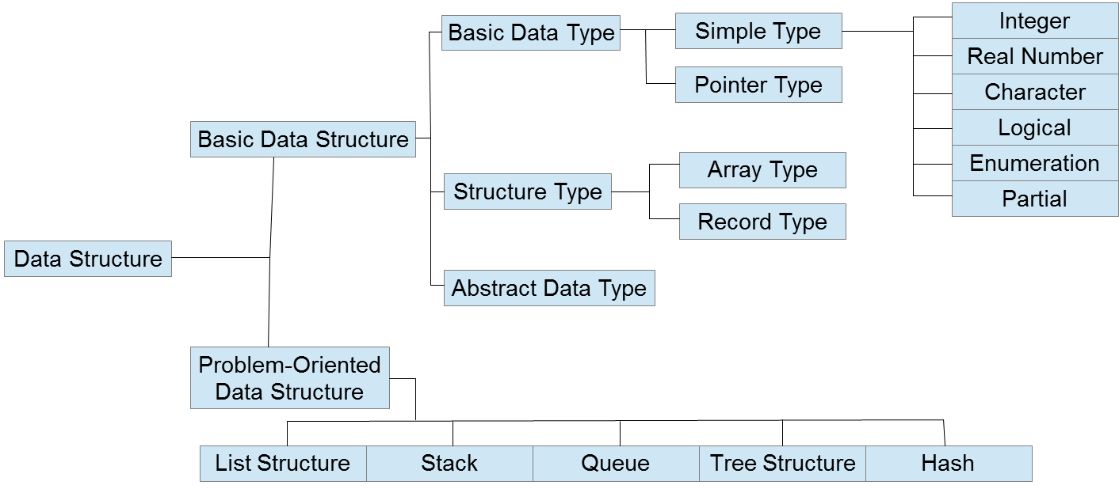
Data Structures

Slide 46
BasiC Data Structure

Slide 47
BasiC Data Structure
Basic Data Type
is a set of individual data and is frequently used to create program.
Simple Type
the data type is usually declared according to the syntax rule of language.
Integer Type
Real Number Type
Character Type
Logical Type
Enumeration Type
Partial Type

Slide 48
BasiC Data Structure
Pointer Type
is used to refer to variables as file records of functions.

Slide 49
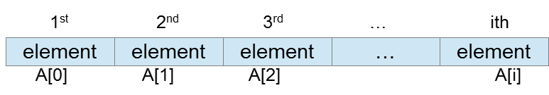
BasiC Data Structure
Structured Type
contains a basic data structure or any of defined data types as its elements.
Array Type
is a structure that contains data of the same type and size.
An array is called a table.
One – Dimensional Array
where data is arrayed in a line.

Slide 50
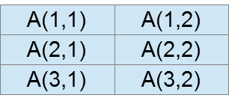
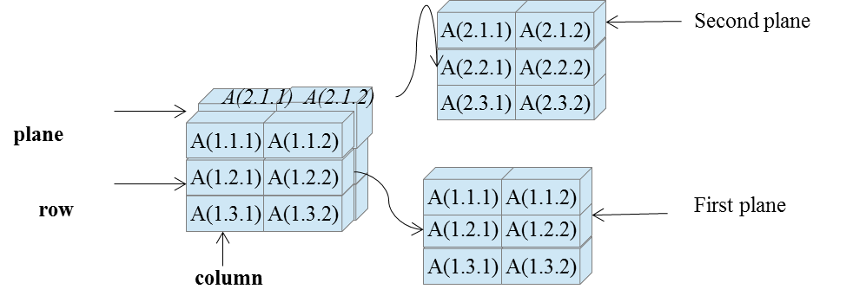
BasiC Data Structure
Two – Dimensional Array
where data is lined up in both vertical and horizontal directions.
Three – Dimensional Array
where it is comprised of planes, rows, and columns.

Slide 51
BasiC Data Structure
Array Type
Arrays can be classified into static array
an array for which a required area is determined by a program, and dynamic array where in an array for which a required area is determined after a subscript used for arraying is provided with an expression and the expression is evaluated during execution of a program.

Slide 52
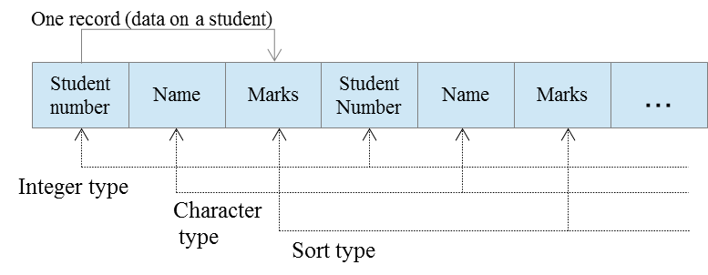
BasiC Data Structure
Record Type
is a form taken by a data that contains data of different types.

Slide 53
Problem – Oriented DATA Structure

Slide 54
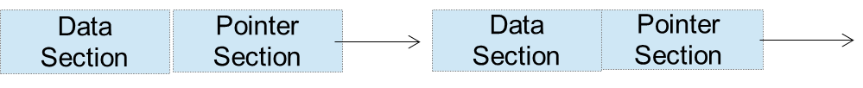
Problem – Oriented DATA Structure
List Structure
allows data to be linked to each other and handled in one lump, this also allows data element to be inserted or deleted easily. A list is data arranged according to the list structure.
The list contains cells and each cell consists of the following:
Data Section that contains data element.
Pointer Section that contains an address.

Slide 55
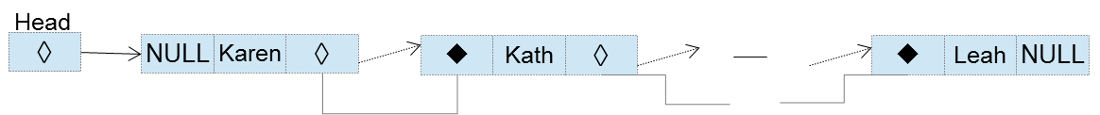
Problem – Oriented DATA Structure
The three types of list structure are:
Uni – Directional List - where the pointer section of a cell contains the address of a cell in which the next data is stored.
Bi – Directional List - has two pointer sections (◊ and ) which contains cell addresses.

Slide 56
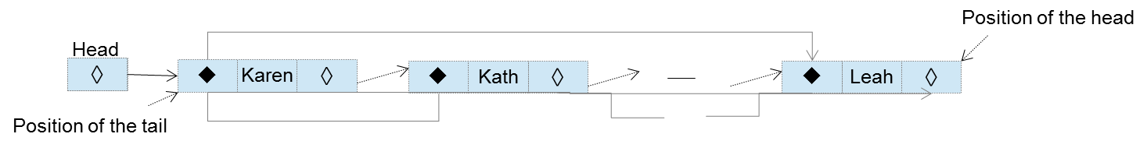
Problem – Oriented DATA Structure
Ring List - a bi-directional list containing NULL in the first cell where the pointer section of the first cell and pointer section containing NULL of the last cell contain addresses of one another.

Slide 57
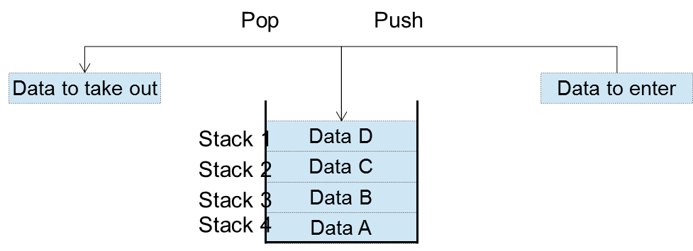
Problem – Oriented DATA Structure
Stack (Last-In-Last-Out)
is a data structure designed based on one- dimensional arrays. Last stored data is read first.

Slide 58
Problem – Oriented DATA Structure
Queue (First-In-First-Out)
is also designed based on one-dimensional arrays, where first stored data is read first.

Slide 59
Problem – Oriented DATA Structure
Tree Structure
has a hierarchical structure like a company or a family tree. It can control complex data better than array- or list- type data structures.
The tree structure consists of elements shown below:
Node - corresponding to data.
Branch - connecting one node to the other.
Root - Highest-order node that has no parent.
Child - Node that branches off under a node.
Parent - original data before it begins to branch.
Leaf - lowest-order node that has no child.

Slide 60
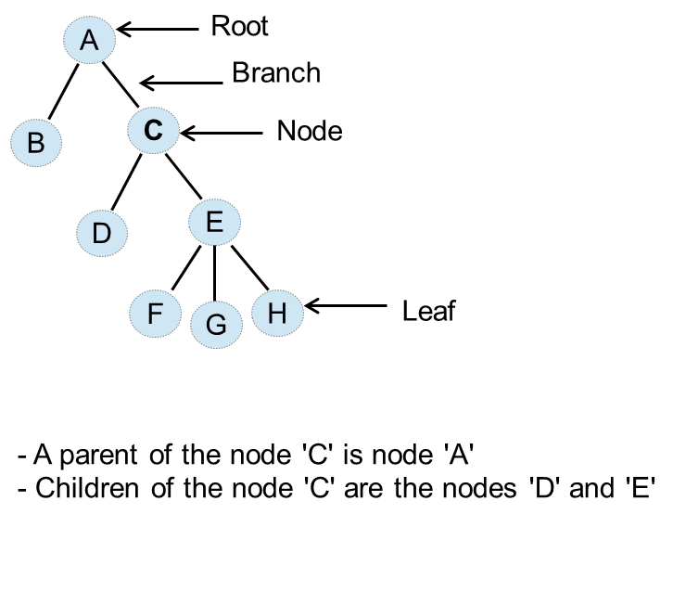
Problem – Oriented DATA Structure
Tree Structure

Slide 61
Problem – Oriented DATA Structure
Hash
is a way of using an array -type data structure. You can directly access specific data using a key without accessing recorded data one by one.
A hash function is used to convert a key to a hash address. Synonym (collision) is when a key is converted to an address using a hash function, different keys can be converted to the same address. Home record is a record that can use the converted address. And a synonym record is a record that cannot use it.

Slide 62
Basic Concepts Of Computer Programming

Slide 63
Basic Concepts Of Computer Programming
Character Set
Data Character Set
Special Characters
Ex. + - * / ( ) , . ` $ and etc.
Numeric Characters
Ex. 0 to 9
Alphabetic Characters
Ex. A to Z

Slide 64
Basic Concepts Of Computer Programming
Character Set
Arithmetic Operators
Addition +
Subtraction –
Multiplication *
Division /
Exponentiation ^
Integer Division \
Modulo Division %

Slide 65
Basic Concepts Of Computer Programming
Character Set
Conditional Operators
Equal to ==
Less than <
Greater than >
Less than and equal to <=
Greater than and equal to >=
Not Equal to <> or !=

Slide 66
Basic Concepts Of Computer Programming
Character Set
Logical Operators
NOT - Unary Operator
AND / OR - Binary Operator
Punctuation
Colon (used after procedure labels) :
Comma (used to separate data names in a data list) ,

Slide 67
Basic Concepts Of Computer Programming
Constant – a quantity or value which does not change.
Numeric Constants
Non – numeric or String Constant
Variable Name – a data address that may assume any one of a specified set of rules.
Numeric Variable
String Variable
Move Operation – causes the value of a data address to change. The symbol is =.
Arithmetic Operation – is the evaluation of an arithmetic expression.

Slide 68
Basic Concepts Of Computer Programming
Hierarchy of Operations
Expressions inside a parenthesis
Exponentiation
Multiplication / Division (from left to right)
Integer Division
Modulo Division
Addition / Substation (from left to right)

Slide 69
Basic Concepts Of Computer Programming
Conditional Operation – resolution of a logical expression into a single value TRUE or FALSE.
Counter – is a data storage for counting. The incremental value for a counter is fixed and is usually 1.
Accumulator – has the same function as counter but different from a counter in the sense that the incremental value for an accumulator is variable.
Switch – is a data storage which varies only between two values, 0 to 1, “On” and “Off”.

Slide 70
Flowcharting

Slide 71
Flowcharting
It is a design aid used by problem analysts in the solution of computer-related problems.
It is a means of visually presenting the flow of data through
an information processing system.
the operations performed within the system.
the sequence in which they are performed.

Slide 72
Flowcharting
What is flowcharting?
It is a design aid used by problem analysts in the solution of computer-related problems.
It is a means of visually presenting the flow of data through
It is a means of visually presenting the flow of data through
the operations performed within the system.
the sequence in which they are performed.

Slide 73
Flowcharting
Advantages
Communication: Flowcharts are better way of communicating the logic of a system to all concerned.
Effective analysis.
Proper documentation
Efficient coding: Flowcharts act as guide or blueprint during the systems analysis and program development phase.

Slide 74
Flowcharting
Types of Flowcharting
System Flowchart
visually describes the operations performed on data through all parts of data processing system.
Program Flowchart
pictorial representation of a procedure. It is used to indicate the flow and sequence of detailed steps in a procedure.

Slide 75
Flowcharting
Symbols
Terminal Box - signifies the beginning or end of the procedure.
Initialization Box - signifies the preparation of data.
Flow Lines - signifies the preparation of data.

Slide 76
Flowcharting
Symbols
Input / Output Box - used for reading or writing data.
Process Box - used for reading or writing data.
Decision Box - signifies conditions which have to evaluated.

Slide 77
Flowcharting
Symbols
Connectors – used to enclosed labels.
On Page Connector
Off Page Connector

Slide 78
Flowcharting
Control Structures
Sequence Structure
Control flows from one
process box to another

Slide 79
Flowcharting
Control Structures
Selection Structure
Provides for a choice
of one between two
alternatives.
A
T
C
F
B

Slide 80
Flowcharting
Control Structures
Do – While Repetition
C
F
T
A

Slide 81
Flowcharting
Control Structures
Do – Until Repetition
A
C
T
F

